Slide 1


Using R to save clinician time and to aide research; automatically extracting paediatric lung function data using open-source Optical Character Recognition package (Tesseract)
Dr Ruchir Shah
Dr David Lo
Dr Ali Hakizimana
Prof Erol Gaillard
Radiology Specialty Registrar (Oxford)
Paediatric Respiratory Consultant
Foundation Doctor
Associate Professor in Child Health and Paediatric Respiratory Consultant

Slide 2

Declaration of interest
Notes:
I am no programmer – self taught
Unsure what to expect so I will go through the process

Slide 3
The Problem
Medical problem:
Children have asthma – we don’t understand how their lung function varies over time
Logistical problem:
Spirometry data stored as PDF’s of variable formats in various different subfolders
Notes:
In various subfolders with other files
Format of pdfs slightly varies over time and as company updates its software
Manually opening and copy and pasting correct data from PDF’s

Slide 4
Failed attempts
X
We approached the spirometry equipment company
Use/R PDF reader packages
XX
Notes:
Why try hard for something that might be really easy – they say it is all in their database..
Odd file format – came back as winddings
Pdftools – scaffold of each individual document

Slide 5
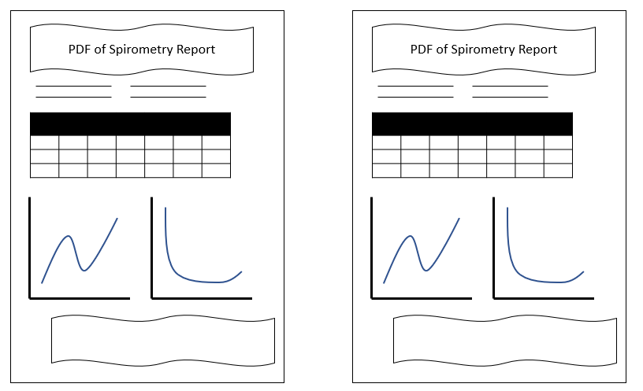

Slide 7
Solution
/R package: Tesseract
https://cran.r-project.org/web/packages/tesseract/vignettes/intro.html
OCR = Optical Character Recognition
Challenges:
Downloading R and Rstudio onto NHS computer
Notes:
OCR – did require optimisation of image
Code on github
Data stayed local

Slide 8
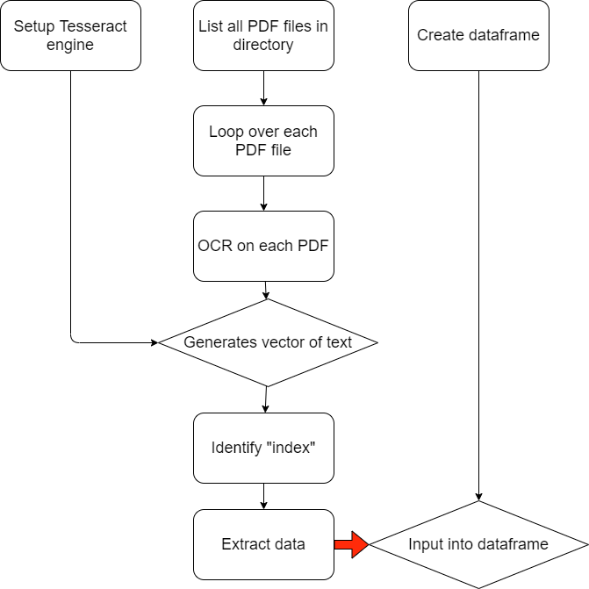
Code
/R package: Rspiro
https://cran.r-project.org/web/packages/rspiro/
Notes:
Libraries tidyverse + tesseract
Talk about rspiro

Slide 9
Results
1724 PDF’s to be analysed
Manual extraction = 100 seconds per PDF
Script extraction = 20 seconds per PDF + (8 hours to write)
= 30 clinician hours saved

Slide 10
Summary
Data extraction from PDF’s consider Tesseract – saves clinician time and can inform practice
Make friends with IT!
Script can be ran on entire cohort
Thank you:
Dr Steve Harris for introducing me to /R
IT Support

Slide 11
PDF of Spirometry Report

